Slide 1
Is My Child on Track?
Tips, Tricks and Look Fors to Empower Parents As Partners in their Child’s Healthy Development
Toni Franchetto RECE
Notes:
Hello, My name is Toni Franchetto. I am a mother, educator and partner. I have two children at home, one is 13 and one is 5. They are both very spirited children and make for an interesting family experience and a great need for me to dig deep within my internal energies to hold onto that curiosity of learning and parenting with love. I am continuing my learning journey with a new role as an Early Childhood Resource Consultant. I am also always learning in all that I do. Thank you for joining me today and I hope that you can find useful tips to create positive parenting strategies to support your child’s healthy growth and development.

Slide 2
Housekeeping :o)
Everyone learns and understands things at their own rate and level! But, everyone LEARNS.
Notes:
Welcome! Today we are going to talk a little bit about child development and go over some helpful hints to encourage healthy development in your child. There will be a short amount of time for you to ask some questions at the end of the presentation, please be mindful of others and ask questions in a positive way. We are always learning and growing together and positivity makes this process enjoyable. There is no such thing as a silly question, we are all at different points in our parenting journeys and we all learn at different rates. This is also important to note about our children, everyone learns at a different pace, it is important to work towards moving onto the next rung in the learning ladder. We are all here today to support the healthy development of our children. Enjoy, have fun and be curious!

Slide 3

Where should my child be?
Five Domains
Social
Emotional
Communication (language and literacy)
Cognitive
Physical
Notes:
So let’s get started!We are going to take a look at how children learn and understand the domains of development for your child. There are 5 domains or areas of learning that are key in your child’s healthy development and growth. These domains are inter-connected throughout your child’s development and growth, there is no all important area of development rather all five domains need to be nurtured and supported in learning and growth. The five domains are:
Social-the ability to make and maintain relationships.
Emotional-the ability to identify and understand our feelings and read other’s
Communication-the ability to understand and express ourselves through words and motions
Physical-The ability to move and control our bodies
All five of these domains develop together and build off each other.

Slide 4
Helping my child grow in learning
Tips for Healthy Growth
Know where your child is at
Build on what your child is learning
Don’t compare your child’s growth to another child
Ask professionals questions
When it comes to behaviour or reactions, stop and ask “WHY”?
Have fun and Play!
Notes:
Now, let’s take a look at some tips for healthy growth and development in children. The first tip si know where your child is at. Pay careful attention to your child’s interests, any repetitive behaviours you see them working on or repeated play patterns you notice, what types of play that they gravitate towards, struggles they may be having.
The second tip is to build on what your child is learning. Play with your child and model new skills they may be working on, for instance, if your child is trying to build with lego blocks. Pick up the lego blocks and put them together and take them apart, over and over, model for your child how the blocks work and connect with each other. Maybe drop a block and make a surprised face, talk through your experience, “Oops, I dropped a block, now I need to pick it up and stack it on the other block again. Now you try.”
Number 3 is very important, Do not compare your child’s growth with another child’s growth! We are all individuals and grow at our own rates, notice where your child is and continue to move them through playful interactions to build on that growth.
The fourth tip is to pose your questions to professionals! If you notice your child is struggling and you have tried to create playful interactions to promote growth but still they are struggling talk to your doctor or another professional who can provide you with guidance and next steps or resources.
The fifth tip is to stop and ask “WHY?”. When you notice struggles in your child’s growth, be curious! Look further into their actions and uncover the real reason behind the behaviour.
And the last piece, is to have fun and play, enjoy this experience with your child! You are your child’s most loved toy and you can use this to help your child grow through play and love.

Slide 5

Play is How We All Learn Best!!
The late Dr. Karyn Purvis, Director of Texas Christian University’s Child Development Center stated, “Scientists have recently determined that it takes approximately 400 repetitions to create a new synapse in the brain – unless it is done with play, in which case, it takes between 10 and 20 repetitions!”
Notes:
Play is how we all learn best! It has been discovered that it takes the average person about 400 repetitions to consolidate new learning in the brain, unless it is done through play. They have discovered that it takes only between 10-20 repetitions to come to the same goal. Apply this discovery to your own learning, If you are learning in a hands on way it takes less practice to master that skill than if you were to read it in a book and try to just remember the process. Makes sense? Play is getting into things, exploring and learning in a very efficient and masterful way.

Slide 6
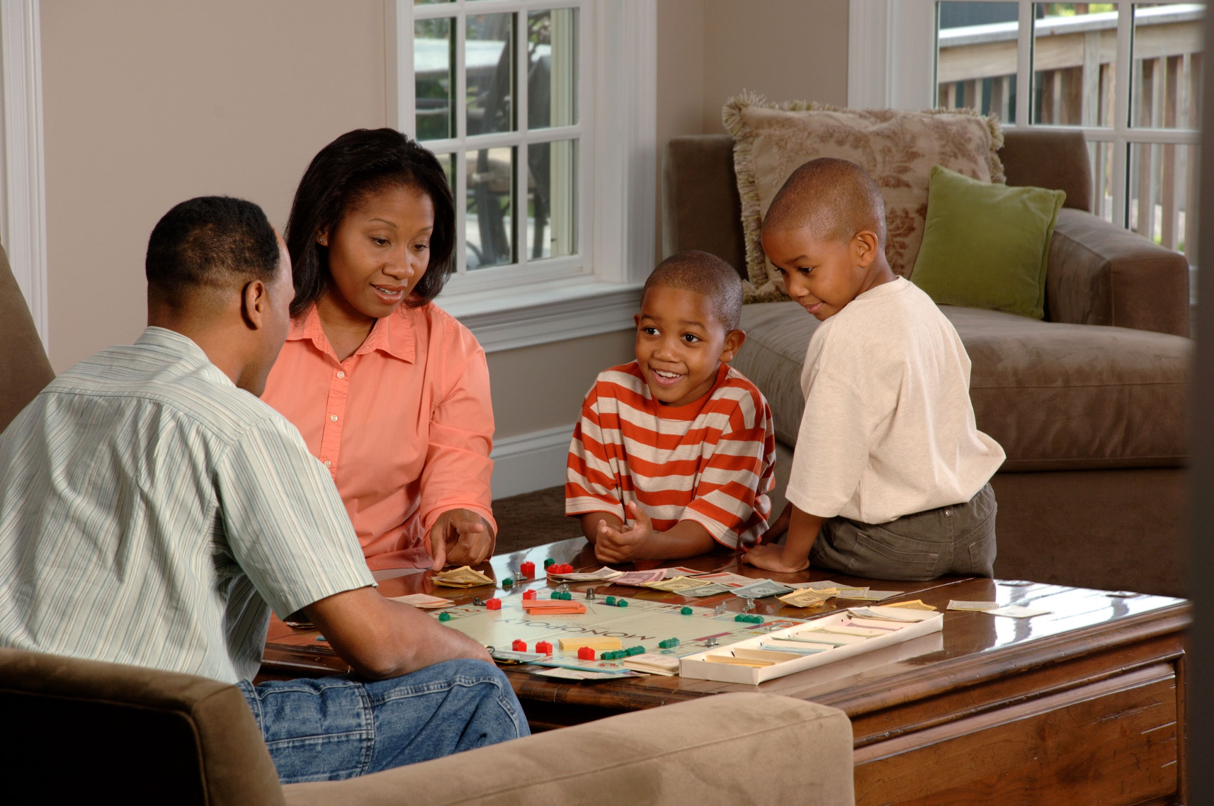


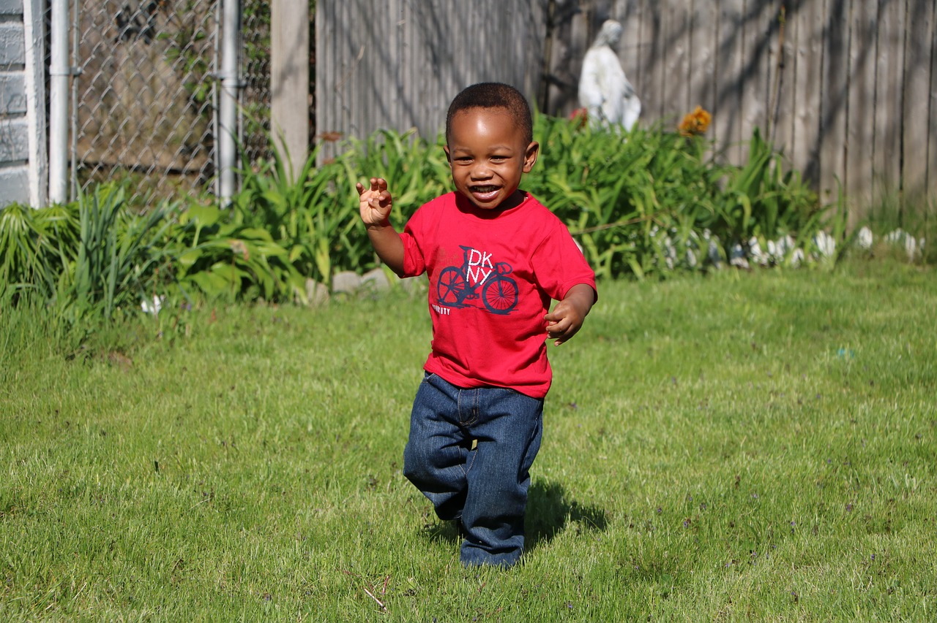

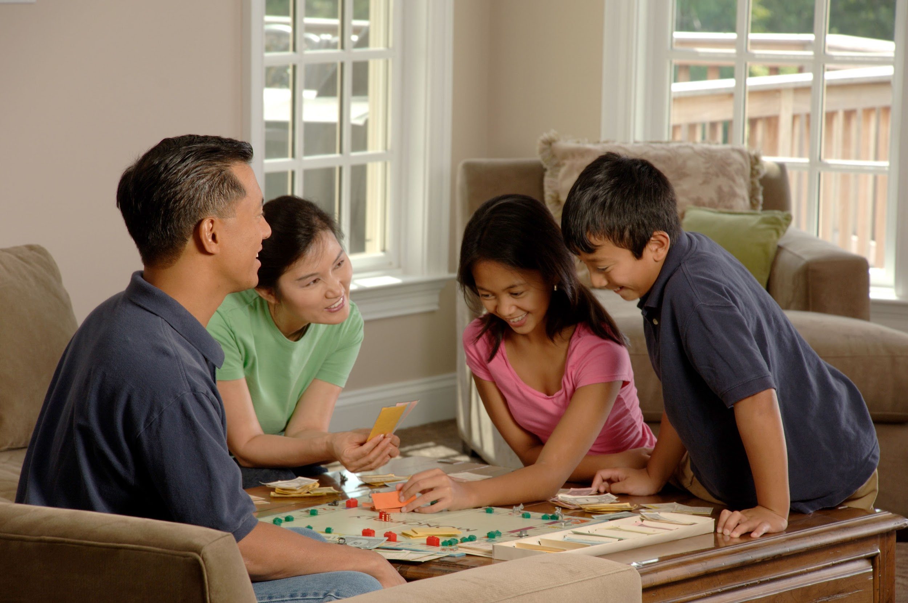

Notes:
Playing with your child and family is the most powerful way to promote learning and growth. Playful interactions with your child, at any level, will help them to retain the learning faster. “Play is the work of children” is a quote from Jean Piaget, a scholar whose work is paramount for all of our Early Learning frameworks in Ontario. This is powerful phrase because playful interactions with our children help to build the foundational learning skills needed to encourage higher order functions. Mary Gordon of the powerful Roots of Empathy Program explains childhood learning in this way, “Love grows brains”, this is very true, the more playful our interactions with our children, the stronger neural pathways are formed and more connections are made or synapses. The more pathways and synapses that our children make the more balanced and healthy their development will be.

Slide 7
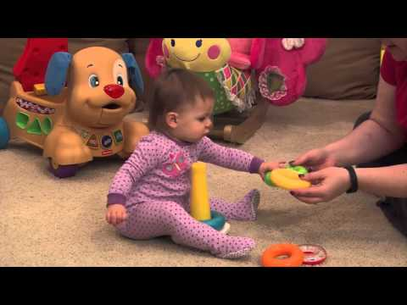
Early Learning and Brain Development
Notes:
Watch this short video that emphasizes the importance of play and parent child interactions. It gives you some information about how your interactions with your child foster brain growth and development. {watch clip}

Slide 8
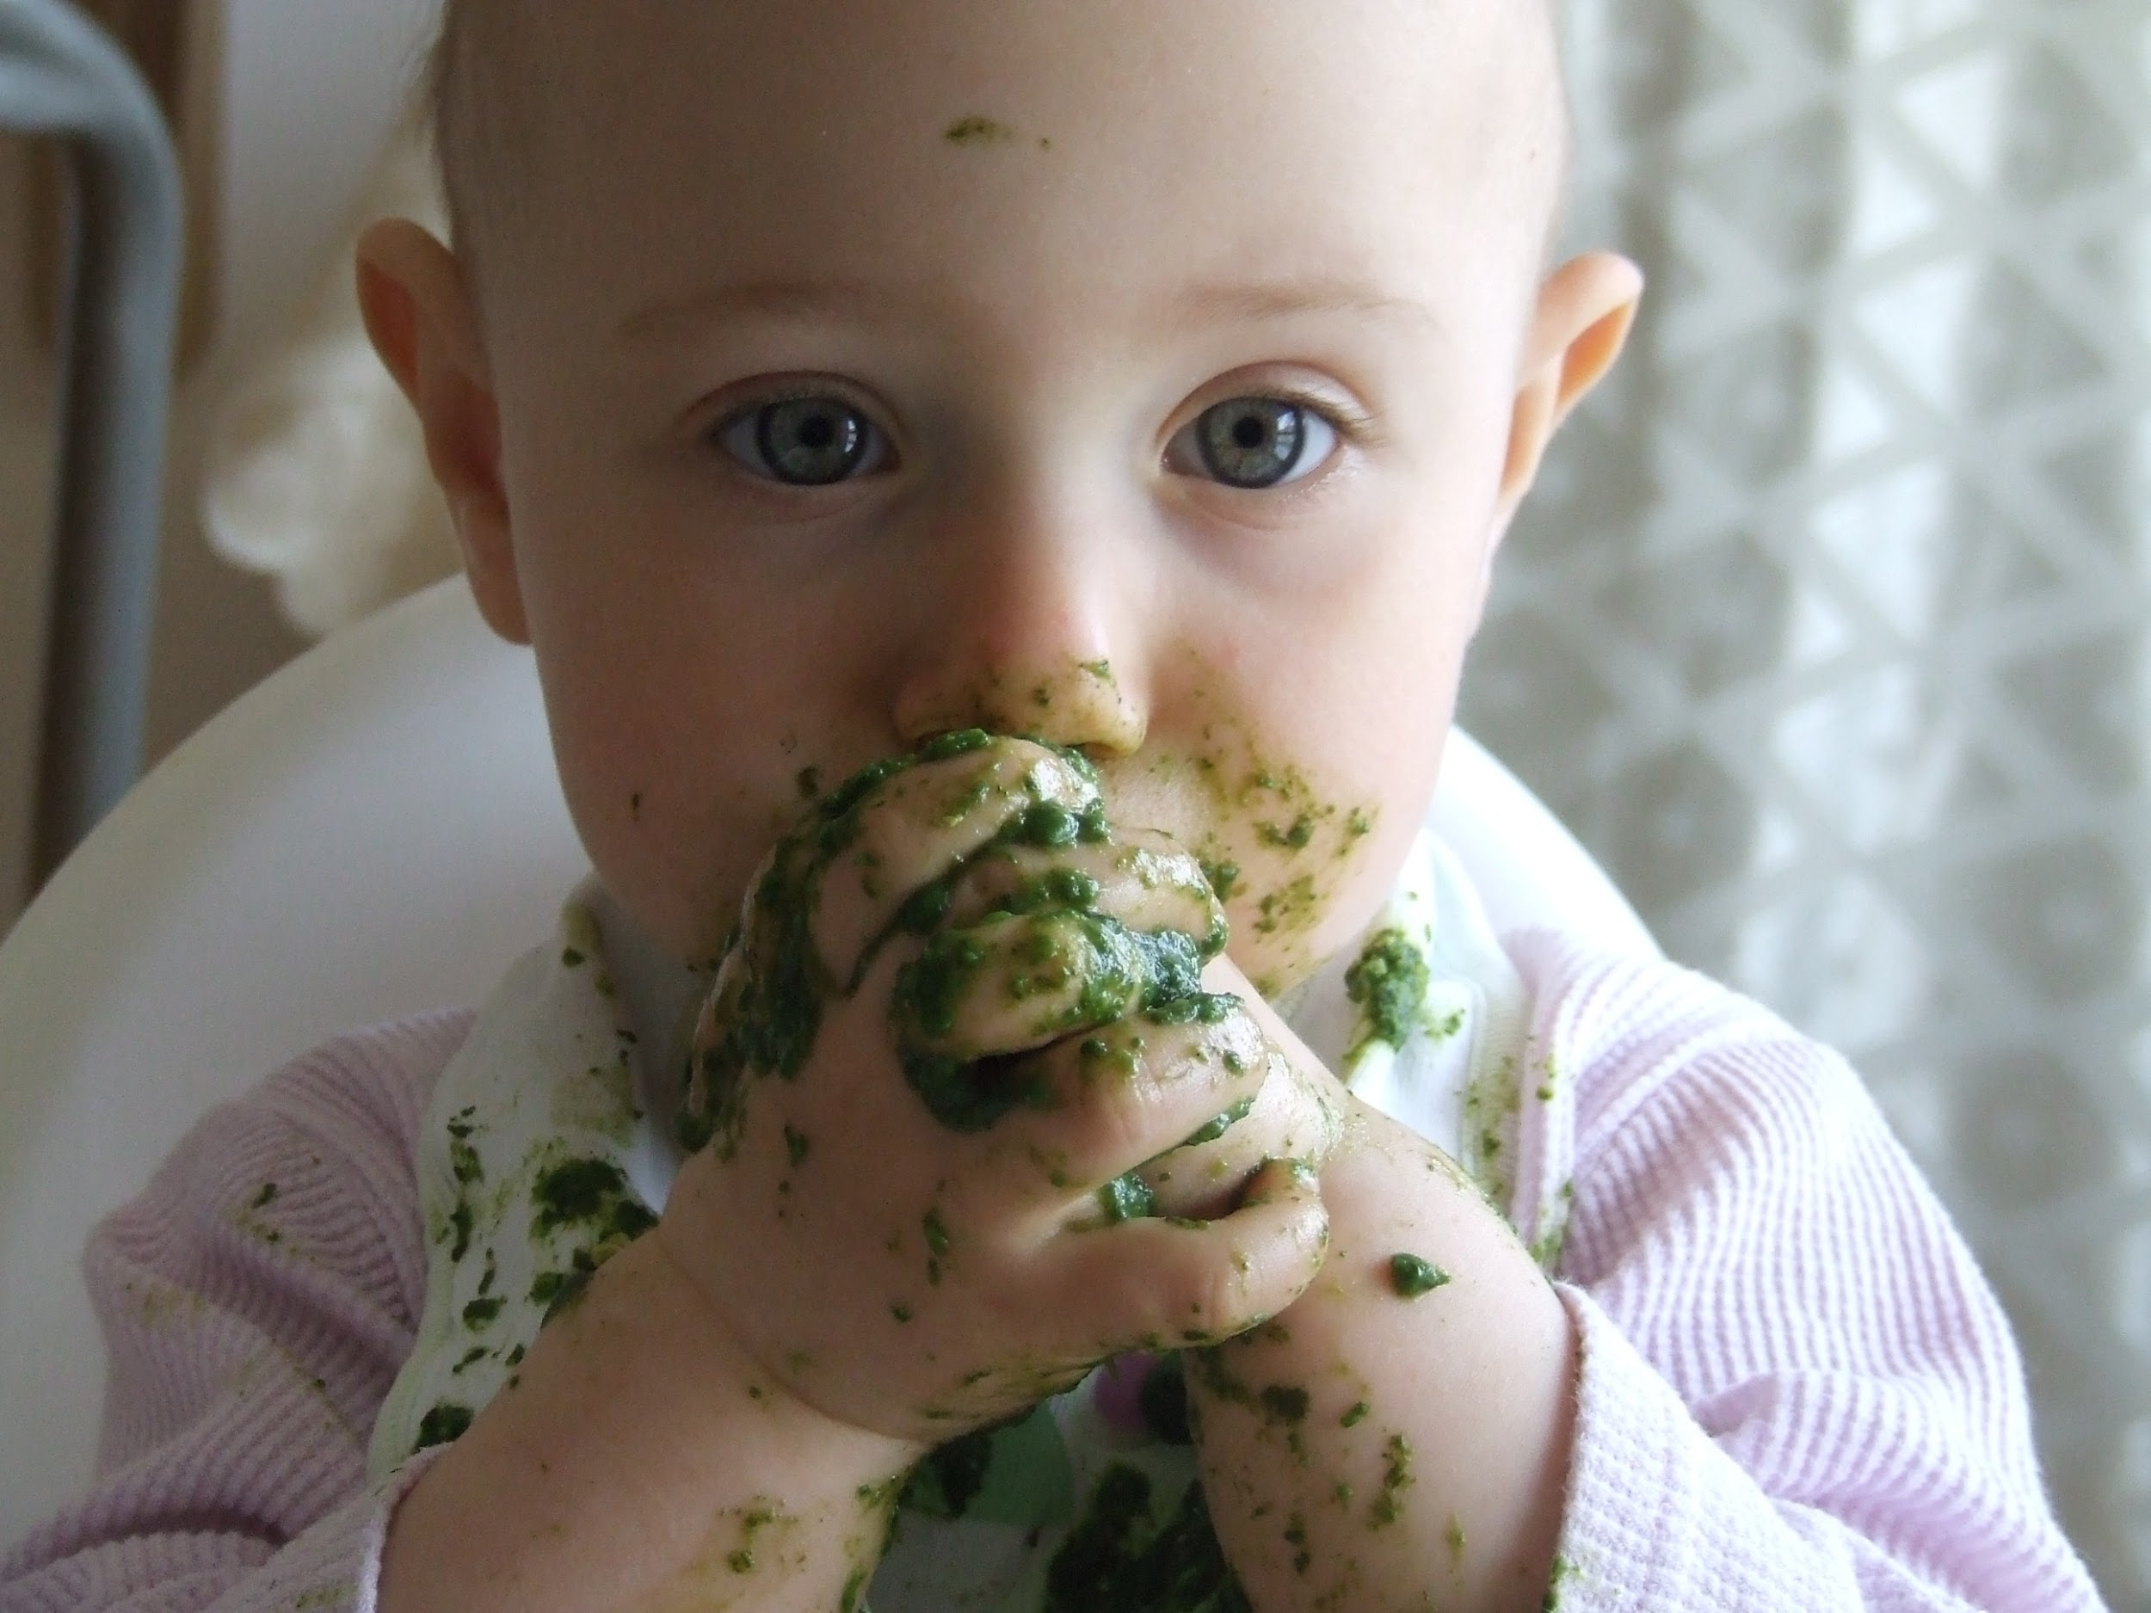
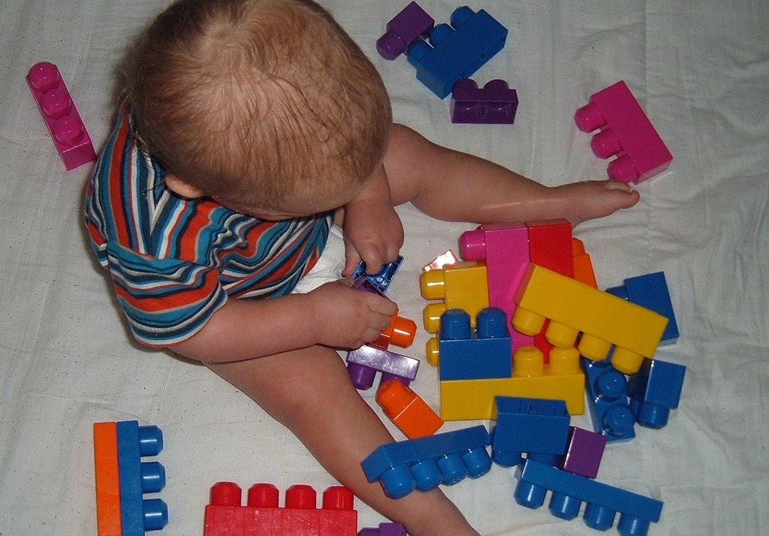
Let’s Put This Into Action...
Your child is colouring and picking things up with a whole hand. You notice that this creates a problem when your child is trying to eat foods independently and play with lego.
What is the problem?
How can you help your child have a more functional experience?
Notes:
When children begin to grasp objects they will use a whole hand to pick things up. They will rarely use their thumbs in this process, as we know our thumbs can be very useful tools. There is not really a problem here, rather a new developmental stage in the physical domain which we can begin to encourage and foster skill mastery in. If we look at the development of this skill through the lens of play, we must first think about the small motor function we are trying to foster. In this case it would be, the purposeful use of the thumb in grasping and holding objects or development of the pincer grasp, a grasp where the child uses the thumb and forefingers to pick up and manipulate objects.

Slide 9
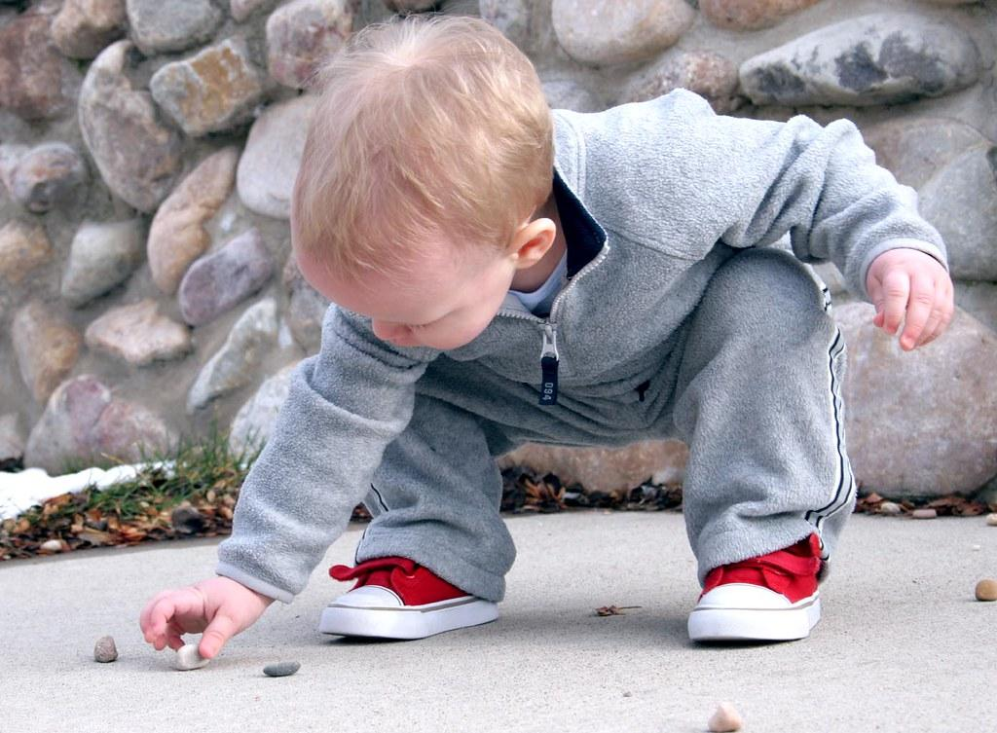
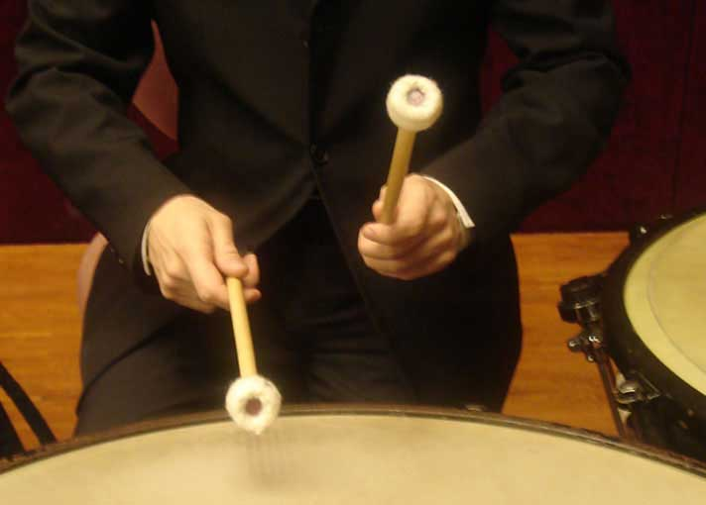
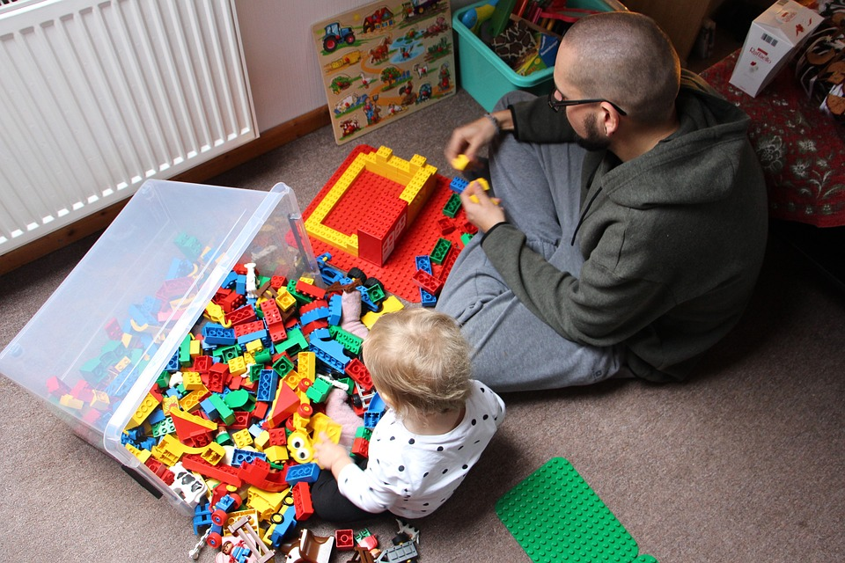
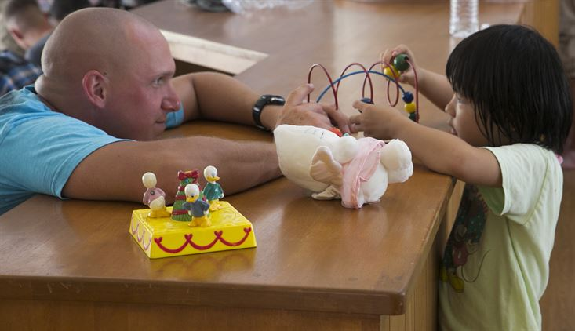
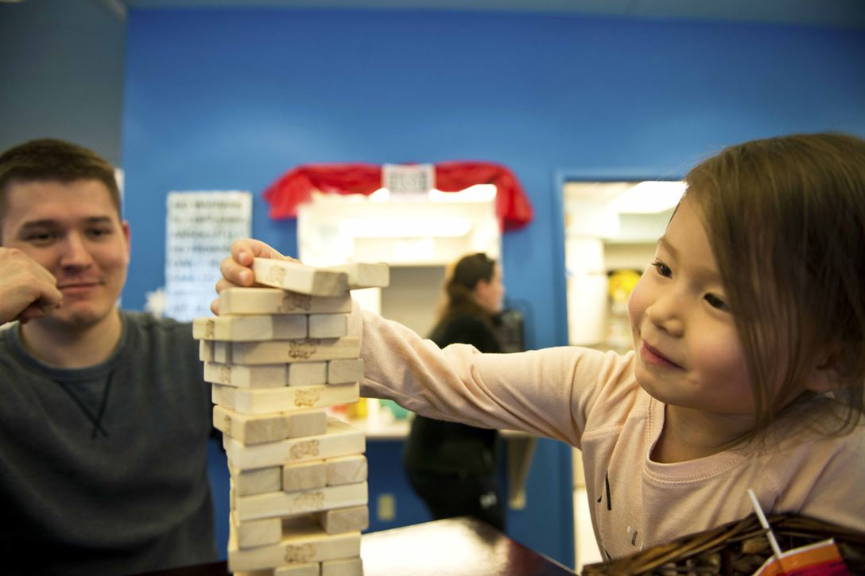
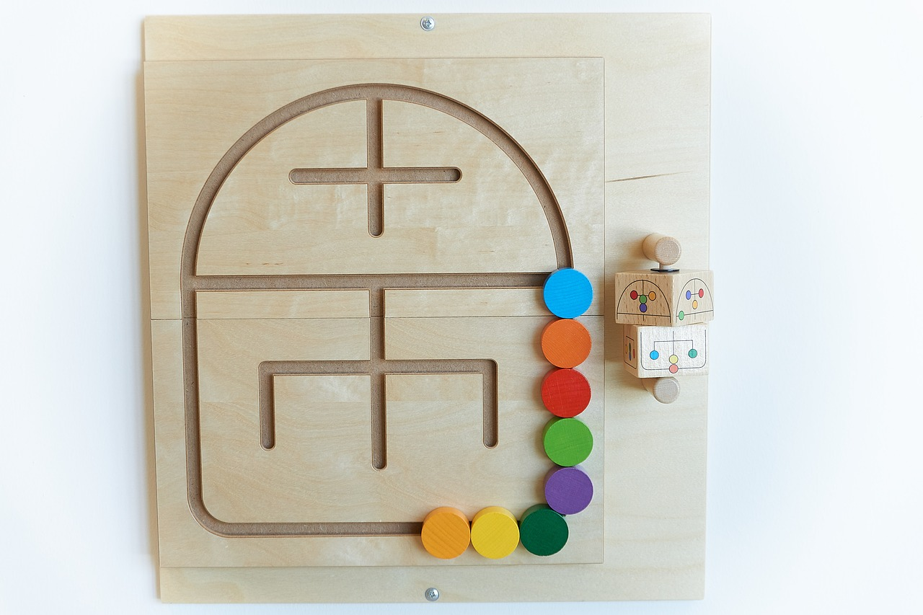
Promoting Development and Learning Through Play and Exploration
Notes:
When we ask questions and investigate what our children are learning and what skills they need to develop in order to support that and further learning, we can understand learning and begin using playful interactions to support that natural development and skill building. In the example, we can see that the child needs to learn how to use the thumb more effectively to support self-feeding and play. If we break that important skill down and look at all the ways and reasons a child needs to use their thumb effectively, we can see numerous benefits to this skill besides just holding a fork or spoon and holding crayons or markers to draw. The effective use of a child’s thumb supports climbing, building, self care, making music, playing with board games and puzzles, drawing and writing, eating, dressing and even the ability for your child to regulate their emotions in play. This one small skill promotes growth in all five domains of development, social, emotional, physical, communication and cognitive. Does your child need this skill to promote growth? Probably not, but it creates less frustration for the child if they can master this skill. Choosing activities to encourage this skill will make it easier for your child to master this skill. Stop and think about your child, what do they like to do? How do they like to play? What activities does your child often go to? Now, use this knowledge of your child’s preferences and tell me how you could create a playful experience to support development in this area of having better function of the thumb during play.

Slide 10
Activities to Encourage Growth
What activities can you think of?
Type it into the chat box or click the google slides question bar at the top of the screen.
Notes:
Please use the chat box below to share your ideas. What does your child enjoy holding or picking up? How can you use that interest to engage in a playful interaction that encourages that forefinger thumb grip? Think about the experiences your child enjoys. You can use some of the squishy toys found at local dollar stores, encourage your child to squish the toy and talk about what your child is feeling, maintain eye contact. You could also put the child in a high chair and give them some cheerios, puffs or raisins, encourage your child to pick them up one at a time, they have books with special spaces to put cheerios into to create pictures. A book like this may interest your child. Creating a picture and adding velcro to certain spots on the picture, to add features to the picture. Then create small objects attached to velcro (pom poms, small bouncy balls etc) and use these items to create the picture. Children like to transfer objects from one container to another, use this interest and fill a bucket with pom poms or small balls, tiny plastic animals and encourage your child to transfer one at a time to the other bucket or container. Remember to use language and talk through all of your interactions with your child. This supports the development of all domains during the playful interaction.

Slide 11
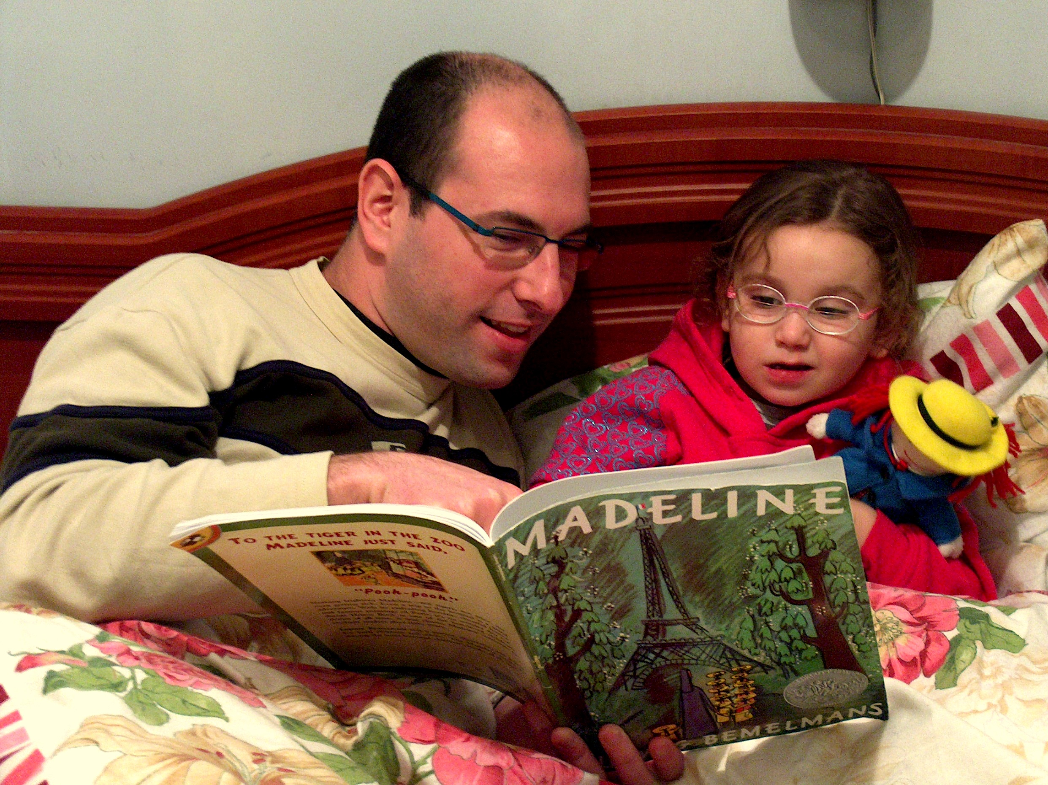

Let’s look at this clip…
What are your thoughts around the bedtime struggles of this family?
http://www.thesuccessfulparent.com/categories/bedtime-strategies/item/bedtime-strategies#.XSOGE-hKhPY
Here is a link to a blog on healthy bedtime routines
Notes:
Let’s take a look at this clip, pay close attention to the child’s behaviour with curiosity. What do you think the child is trying to communicate?
{Play video} What do you think the child wants? What is the behaviour communicating? What would you do differently? How can you encourage healthy sleep habits in a playful way? I notice the father is away for work all week, could the child be wanting more family interaction? Could a small game or play experience be built into the bedtime routine? One where both parents are engaging together with the child? Could a transition warning happen and the parents let the child know there is 30 minutes before bedtime, and ask the child to choose a family activity before bed? Creating a playful bedtime routine where songs and silly rhymes can be used to playfully put the child to bed? Here is a link to a helpful blog. You can take a look at the blog post below for some great sleep tips, just omit the sleep reward chart, external rewarding of children for expected behaviours, like sticker charts or small toys and gifts is a terrible habit to get into. Giving children genuine praise for their efforts is a much healthier way to promote positive growth, an example of this would be “I like how you are showing you are a big kid now by sleeping in your own bed and all night! Wait until Grandma hears this news, did you want to call her and share your big news?”

Slide 12
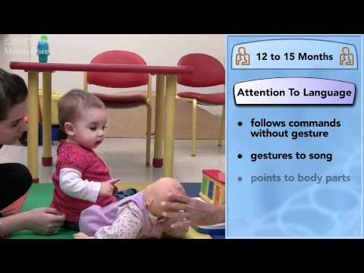
Here are some developmental look for in the healthy social and communication domains. Take a look.
Notes:
We are going to take a brief look at some developmental look fors that you may notice in your child between the ages of 0-2. Remember to note that every child develops at their own rate and these are guidelines. Think about your child while watching the video and note where your child falls in the communication continuum.{Watch clip} What did you think? Can you see what skills your child is displaying and what the next milestones could be? Can you think of playful interactions to help your child develop these skills? Understanding how learning and development occurs in children is a powerful tool we can use to help our child grow in a healthy and developmentally appropriate way.

Slide 13
Questions?
Notes:
Now have some time for any questions you may have. If you are watching the recording take a moment to pause and jot down some quick notes and ideas you can put into action right away, remember that applying your new learning helps to consolidate the knowledge and practice, just like play does for our children.

Slide 14
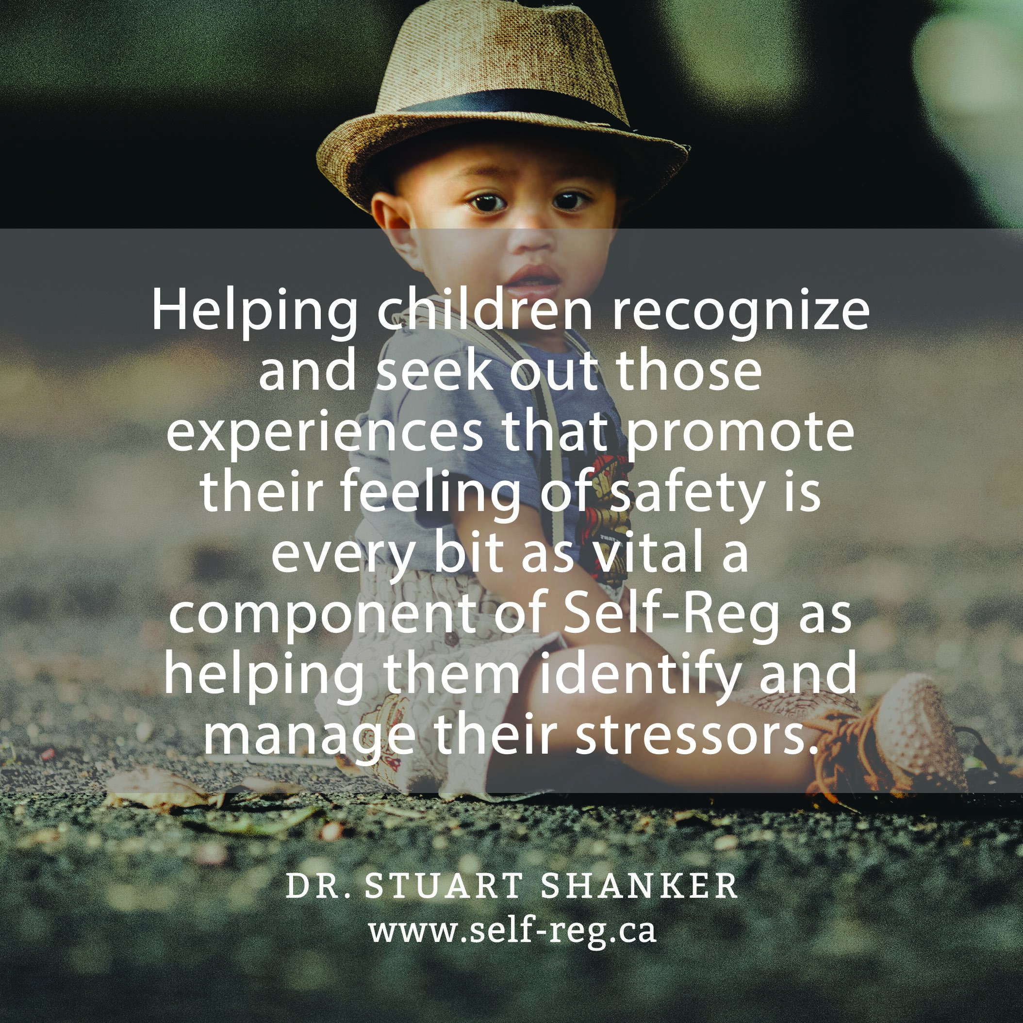
A Big Thank You to all my participants!
Notes:
I just want to thank you for joining me today and if you are watching this in a pre-recorded way, thank you also. I hope you have enjoyed this information session and gained some new skills for supporting your child’s healthy development. I am leaving you with this poster from the Mehrit Centre (Read Poster) it just reminds us that when children are safe and happy they learn best, eliminating and investigating the underlying stressors of children will help our children to be happy and learning.

Slide 15


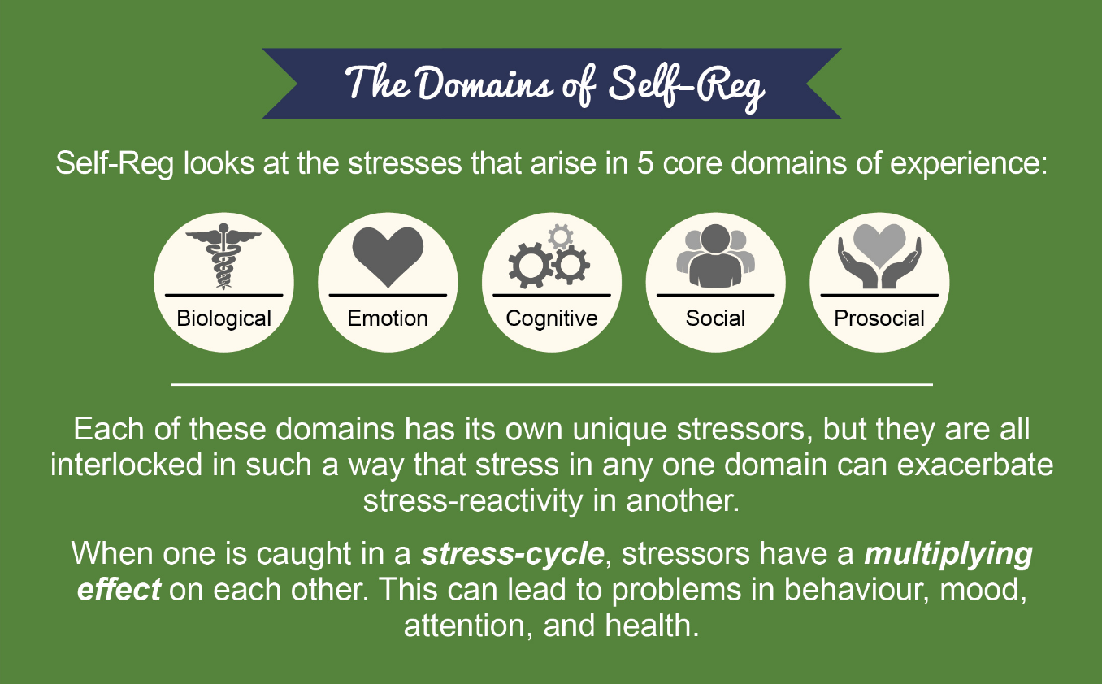
Resources and links
https://lookseechecklist.com/en/ This is a link to free developmental screens from birth to six it also provides a list of useful activities to encourage healthy development
http://www.edu.gov.on.ca/childcare/ExcerptsFromELECT.pdf this is a link to the continuum of development for children from birth to eight, this is helpful to know where your child is at and move them forward at their own pace
https://self-reg.ca/ This site offers a host of useful tools, learnings and resources to support healthy development and positive parenting skill building
Notes:
Here are some resources and links you can access to help build your parenting tool kit. The first is the link to the website where you can access the Nippising Developmental Screen tool. This is a useful checklist that parents can easily use to check if their child is on track in development. Each screen is broken down to specific age ranges and has a quick checklist you can go over and see where your child is at. I love this particular screen because it offers activities that you can do with your child to promote development of skills and encourage healthy growth.
The second link is to the Ontario Government’s framework for learning in childcare programs ELECT. It offers and breaks down the continuum of early learning skills. It is broken down by specific domain and age groups. It gives you an idea of where your child should be and what steps you need to see and do to move on to the next phase in development and learning.
The third link is to the Self-Reg site, this is the product of Dr. Stuart Shanker’s and The Mehrit Centre’s work in the area of child development and self- reg development. This has a great deal of learnings, resources and techniques that you can use to help your child grow and develop in a healthy and beneficial way. There are blogs, Vlogs, PDFs and newsletters along with a host of other resources to help you to support the growth and healthy development of your child.

Slide 16
Here is a great site with helpful parenting tips in a printable format
https://happyyouhappyfamily.com/category/parenting-tips/
Thank you and Enjoy Your Day!
https://forms.gle/TWxdMKpRiPE4Xwcz8
Please follow link to complete a short survey
Notes:
The last thing I am going to offer you is a link to a website that offers some very practical parenting tools and tips. There is access to printables (or cheat sheets) that you can use for very specific concerns you may have. One printable I have accessed in the past was a very simple 5 step chart on What to do during a temper tantrum. It gave 5 steps and examples of what you might say to your child during each step. There are many other useful tips and tools to help you navigate through the challenges of parenting. Thank you again so much for joining me today, I hope I have offered a little bit of guidance in promoting healthy development in children and given you some resources to continue your parenting journey with. Please have a great day and if you could just quickly click on the like to my survey and let me know how I did and what you would like to know more about, it would be a great help to me!

Slide 17
References
Boys Town Hospital. (2015, December 16). Early Brain Development. Retrieved July 09, 2019, from https://www.youtube.com/watch?v=oSn3YRQHcOc
Frazier, B. (2001, August 18). Bedtime Strategies. Retrieved July 8, 2019, from http://www.thesuccessfulparent.com/categories/bedtime-strategies/item/bedtime-strategies#.XSP2eehKhPa
Holmes, K. (2019). Happy You Happy Family. Retrieved July 8, 2019, from https://happyyouhappyfamily.com/category/parenting-tips/
Ontario Gov. (2006). Early learning for every child today: A framework for Ontario’s early childhood settings(J. Bertrand & P. Dickinson, Authors) [Cong.]. Toronto, Ont.: Ministry of Children and Youth Services.
Ndds. (2019). Welcome to the Looksee Checklist by ndds. Retrieved July 8, 2019, from https://lookseechecklist.com/en/
Shulman, L., Dr. (2012, March 07). Baby and Toddler Milestones. Retrieved July 8, 2019, from https://www.youtube.com/watch?v=pZSjm0drIGM
Safrisri. (2012, February 20). "Play is the work of children"..... J. Piaget. Retrieved from https://teachosaur.wordpress.com/2012/02/20/play-is-the-work-of-children-j-piaget/
The House of Tiny Tearaways. (2018, April 30). Family Struggle with Child at Bedtime. Retrieved from https://www.youtube.com/watch?v=xDNjexUGDrU&t=17s
The MEHRIT Centre. (2018). Self-Reg Resources. Retrieved July 8, 2019, from https://self-reg.ca/

